Slide 1
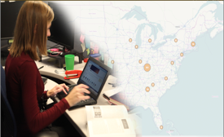
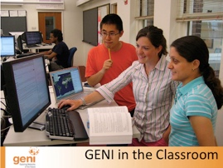
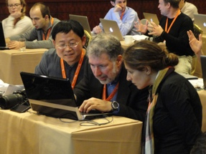
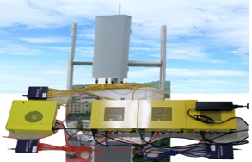
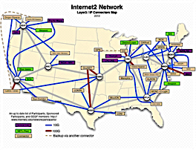
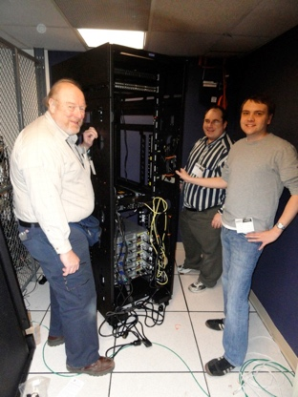
GENI: A Networked Infrastructure for At-Scale Experiments Zongming Fei University of Kentucky Thanks to Abraham Matta (BU), Violet Syrotiuk (ASU), Mark Berman (BBN), Vic Thomas (ATC)
www.geni.net
This document does not contain technology or technical data controlled under either the
U.S. International Traffic in Arms Regulations or the U.S. Export Administration Regulations.

Slide 2
Outline
What is GENI?
Building and deploying GENI
How is GENI being used?
An experimenter’s view of GENI
What’s next?

Slide 3

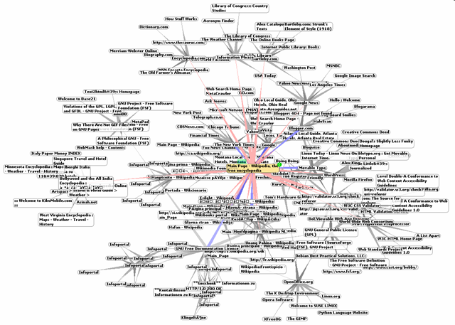
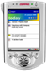

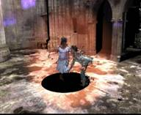

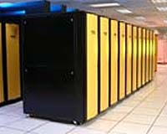
Why GENI?
Science Issues
We cannot currently understand or predict the behavior of complex, large-scale networks
Innovation Issues
Substantial barriers to at-scale experimentation with new architectures, services, and technologies
Society Issues
We increasingly rely on the Internet but are unsure we can trust its security, privacy or resilience
Credit: MONET Group at UIUC
These issues are becoming increasingly important with
ubiquitous connectivity, IoT, cybercrime.
Notes:
3

Slide 4
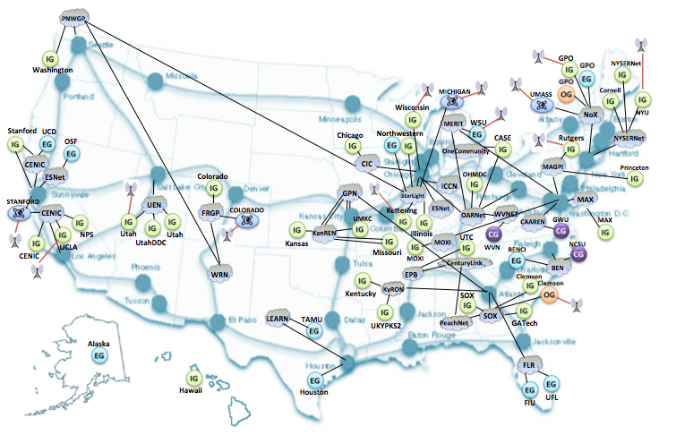
GENI: National Infrastructure for Research in Next-Gen Networked Systems
GENI provides compute resources that can be connected in experimenter specified Layer 2 topologies.

Slide 5
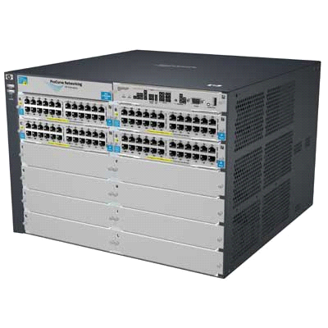
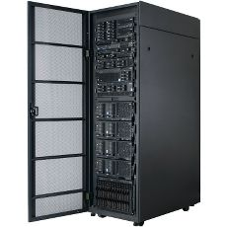
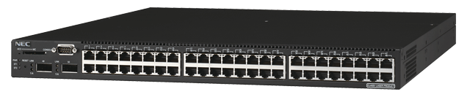
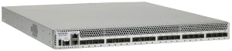

Interconnected GENI Hardware
OpenFlow switches
(50+ campuses, regionals,
and national footprint)
GENI Racks
(50+ campuses
plus regionals)
Research LTE Deployments
(20+ installations)

Slide 6
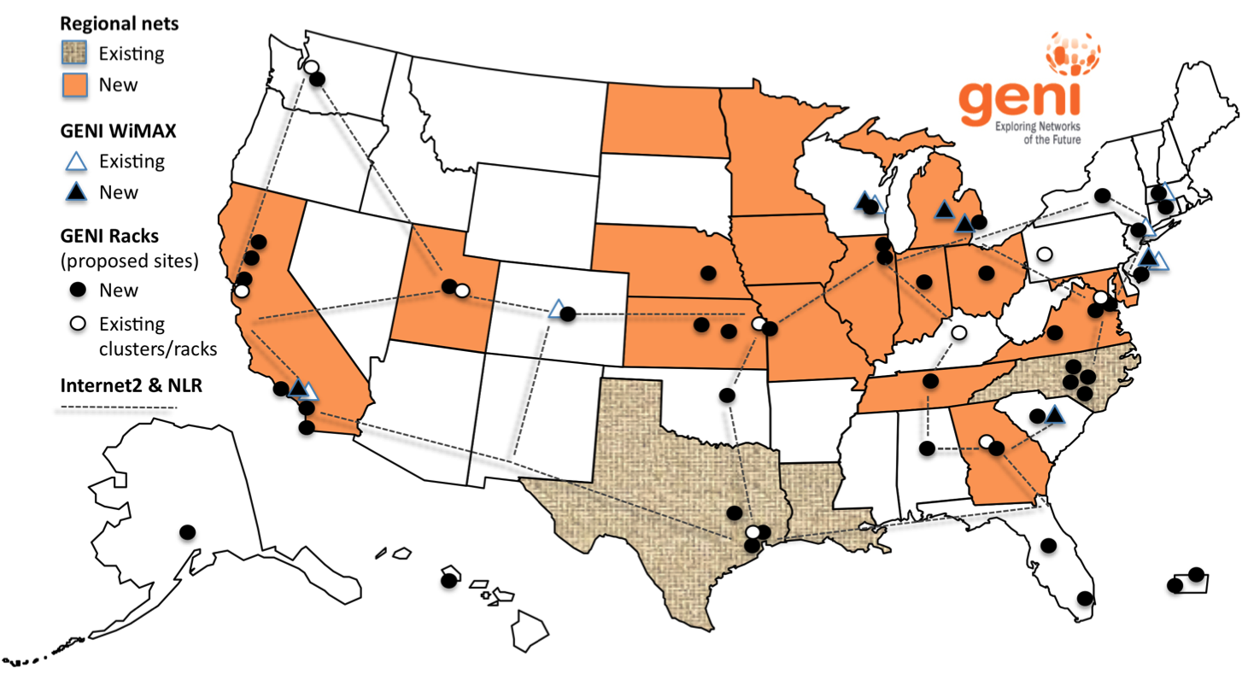
GENI: Infrastructure for Experimentation
GENI provides compute resources that can be connected in experimenter specified Layer 2 topologies.

Slide 7

Multiple GENI Experiments run Concurrently
Resources may be virtualized and used by multiple experiments
Experiments live in isolated “slices”

Slide 8
GENI is “Deeply Programmable”
I install software I want throughout my network slice (into firewalls, routers, switches, …) or control switches using OpenFlow
Everything is programmable: Experimenters create and program custom topologies, protocols and flows

Slide 9



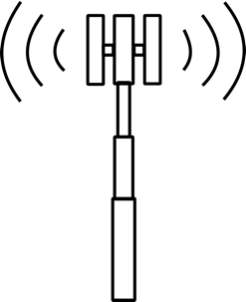



GENI is Precision Cyberinfrastructure
All applications and services rely on cyberinfrastructure
High performance applications and services need precision cyberinfrastructure
The right resources
In the right places
Connected by the right network
Running the right software

Slide 10
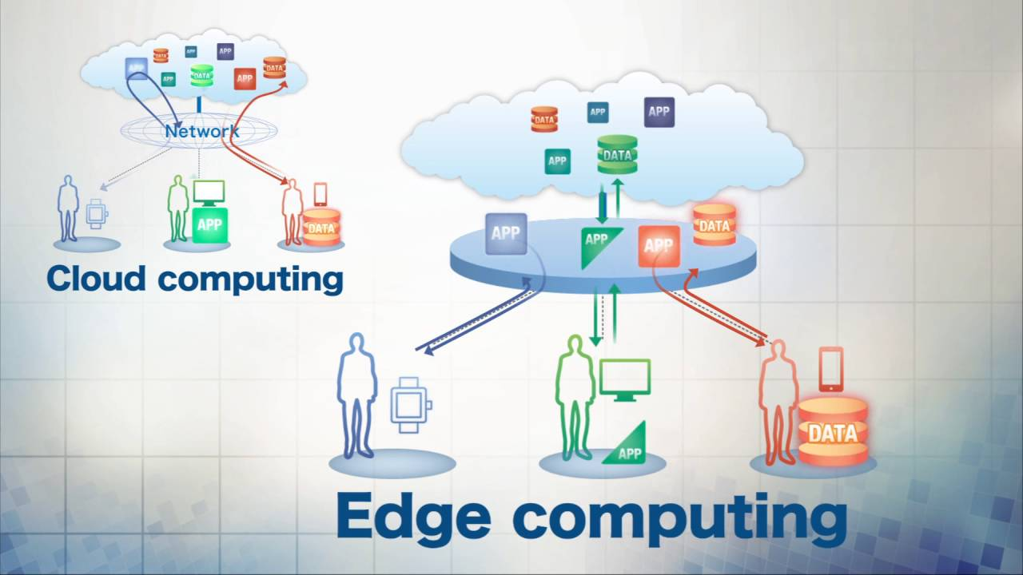
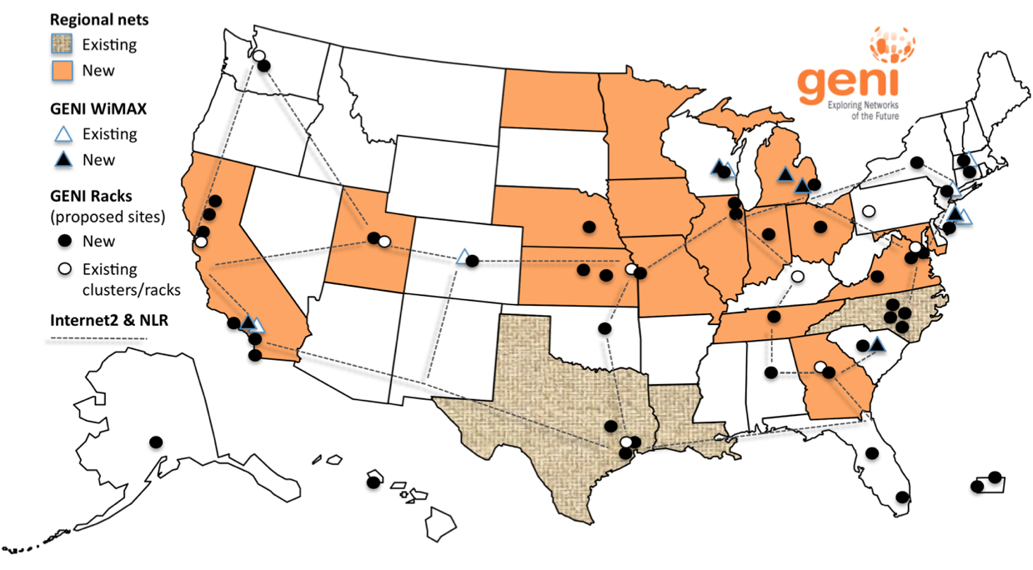

GENI is a Nationwide Edge Computing Platform
Edge computing: A method of optimizing cloud computing systems by performing data processing at the edge of the network, near the source of the data.
https://en.wikipedia.org/wiki/Edge_computing
Graphic from NTT Network Innovation Laboratories
Every rack is a “cloudlet” in the GENI Edge Cloud

Slide 11
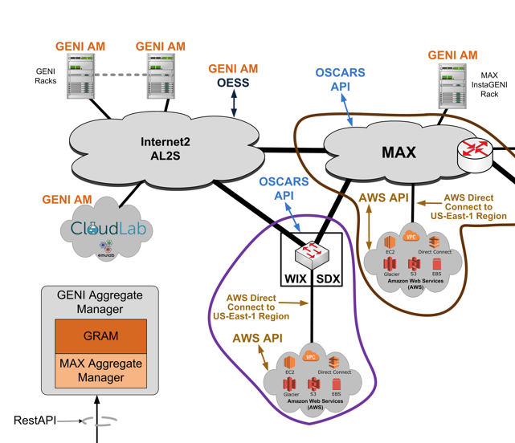

The GENI Edge Cloud connects to ClouldLab, Chameleon and AWS
The GENI Edge Cloud connects to CloudLab, Chameleon and Amazon AWS
Enables experiments that use GENI and ClouldLab/Chameleon/AWS resources

Slide 12
What is Chameleon/CloudLab?
A “meta-cloud” or “cloud factory”
not a cloud itself
rather, a facility for trying many kinds of clouds in parallel
Gives bare-metal access and control over a substantial set of computing, storage, and networking resources
Researchers can install standard cloud software stacks, modify them, or create entirely new ones

Slide 13
Outline
What is GENI?
Building and deploying GENI
How is GENI being used?
An experimenter’s view of GENI
What’s next?

Slide 14
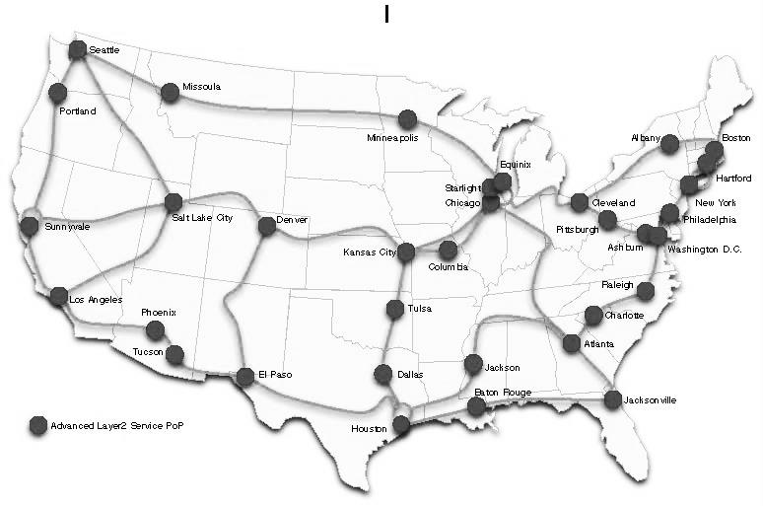


















GENI’s footprint
PNWGP
GPO
NYSERNet
Washington
MICHIGAN
UMASS
Cornell
Wisconsin
NoX
NYU
Stanford
UCD
Northwestern
MERIT
WSU
OSF
Chicago
CASE
Rutgers
NYSERNet
OneCommunity
CENIC
CIC
MAGPI
Princeton
ESNet
Colorado
OHMDC
GPN
ICCN
STANFORD
UEN
StarLight
MAX
CENIC
FRGP
COLORADO
Kettering
ESNet
OARNet
WVNET
UMKC
CAAREN
GWU
MAX
NPS
Utah
Utah
KanREN
Illinois
UTC
UCLA
UtahDDC
Kansas
MOXI
WVN
RENCI
NCSU
CENIC
Missouri
MOXI
CenturyLink
BEN
WRN
EPB
Clemson
Campus Network
WiMAX/LTE
Kentucky
KyRON
SOX
LEARN
TAMU
SOX
Advanced Layer2 Service POP
UKYPKS2
PeachNet
GATech
IG
InstaGENI Rack
ExoGENI Rack
OpenGENI Rack
CiscoGENI Rack
EG
FLR
OG
Houston
UFL
CG
FIU
Regional Network

Slide 15



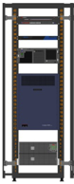






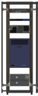


GENI Network Architecture
ISP
Internet
Metro
Research
Backbones
g
g
Layer 2
Data Plane
GENI-enabled
hardware
g
Legend
Layer 3
Control Plane
Campus
Regional Networks
Flexible network / cloud research infrastructure
Also suitable for physics, genomics, other domain science
Distributed cloud (racks) for content caching, acceleration, etc.

Slide 16
Federation GENI grows by GENI-enabling heterogeneous infrastructure
My experiment runs across the evolving GENI federation.
GENI Rack
Commercial
Clouds
Backbone #1
Campus
My GENI Slice
Access #1
Corporate
GENI suites
Research
Testbed
Regional
Non-US
Testbeds
This approach looks remarkably familiar . . .
Emerging Cyber-
Infrastructures
Avoid technology “lock in” and grow quickly by incorporating existing and new infrastructure
Notes:
16

Slide 17
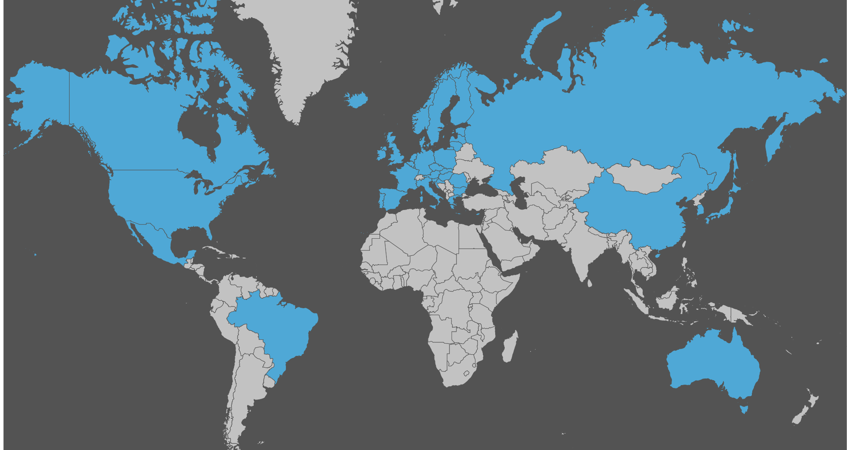
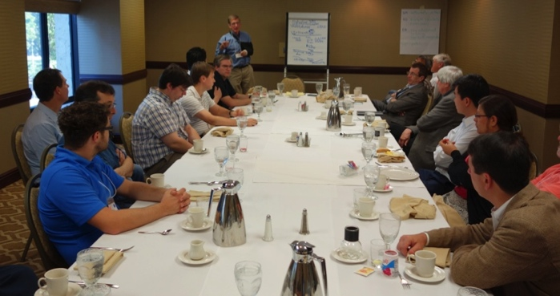
International Federation Extends GENI’s Reach
GENI is working actively with peer efforts on five continents to define and adopt common concepts and APIs.

Slide 18
Outline
What is GENI?
Building and deploying GENI
How is GENI being used?
An experimenter’s view of GENI
What’s next?

Slide 19
GENI Growth
Over 14,000
users
(June 2018)

Slide 20

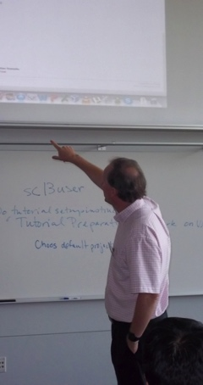
GENI for Research and Education
Research
Future Internet Architectures
Software defined networking
Large scale evaluation of protocols
Cloud networking
Domain sciences
Education
Classes in:
Computer Networking
Distributed systems
Cloud computing
Wireless Communications
Undergraduate, graduate
GENI has over 14,000 users!

Slide 21
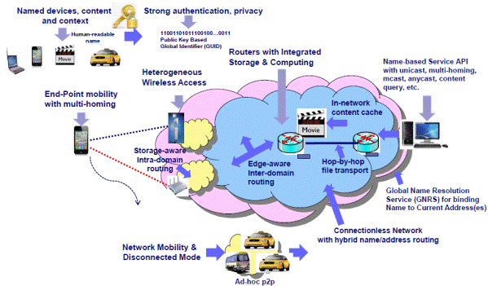
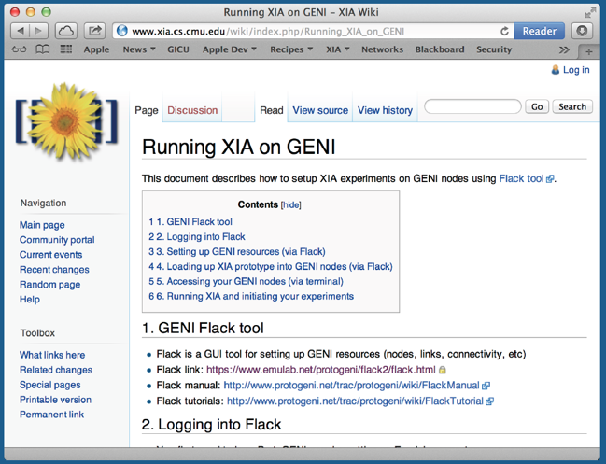
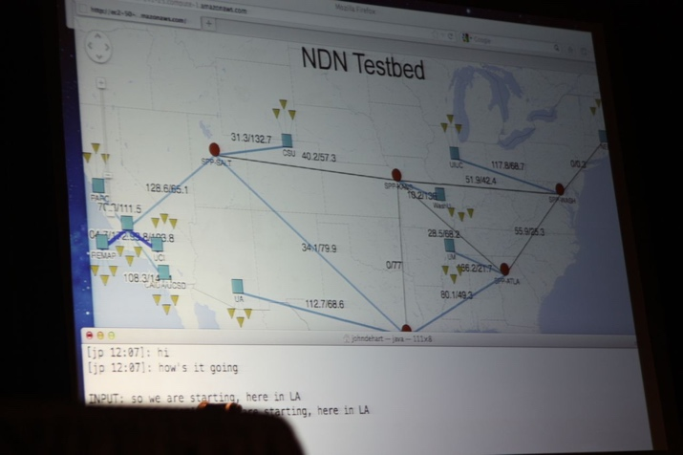
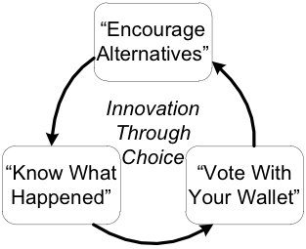
FIA Teams have Slices on GENI
eXtensible
Internet
Architecture
MobilityFirst
Named Data
Networking
ChoiceNet
GENI is the only testbed that can support all these teams.

Slide 22
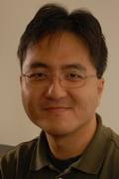
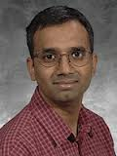
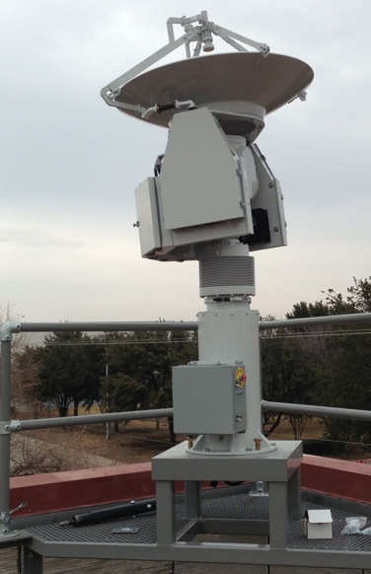
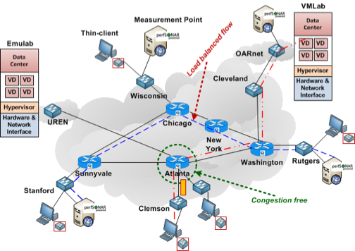
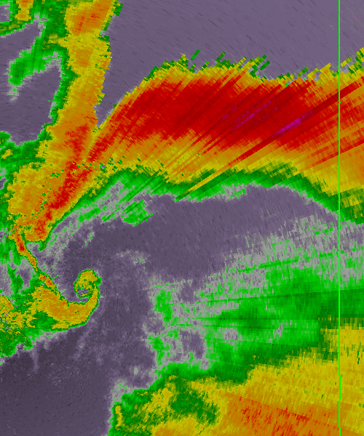

Software Defined Networking Research
KC Wang
Clemson U.
Improve in-time weather forecasting using Software Defined
eXchanges
Parmesh Ramanathan
U. Wisconsin
Mike Zink
UMass Amherst
GENI Cinema
GENI is the largest multi-domain SDN testbed

Slide 23
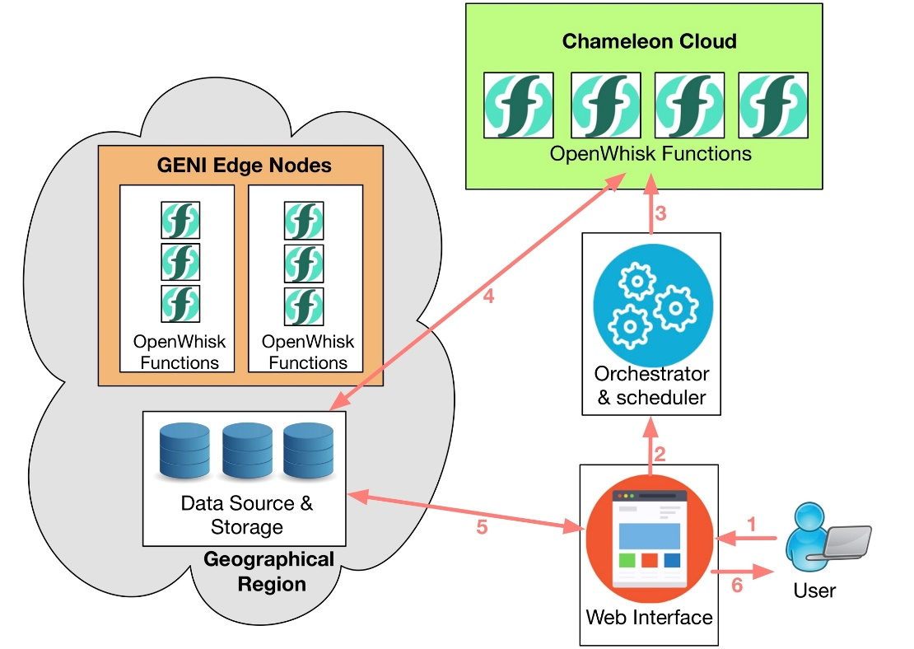
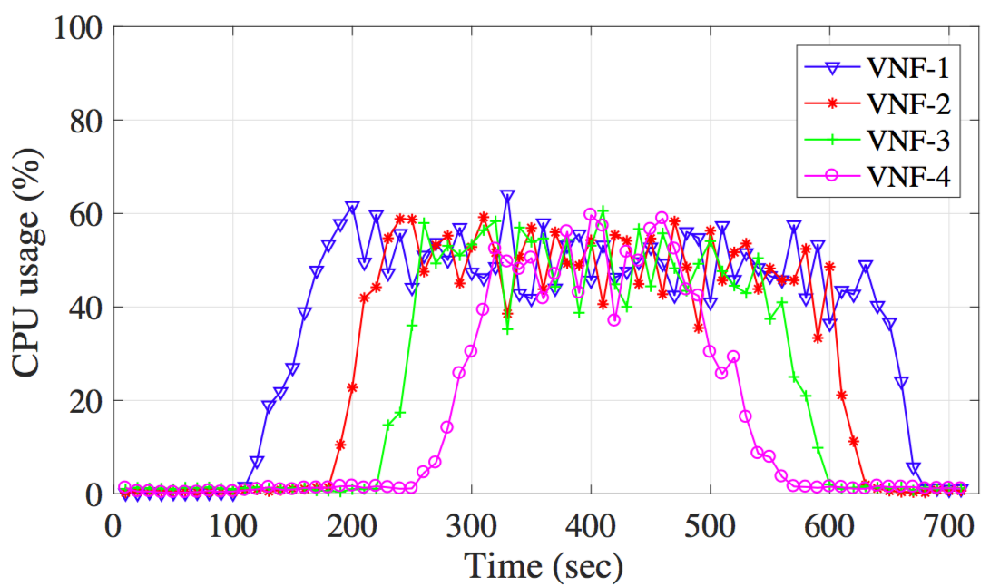
Edge-cloud & Elastic Management Research
GENI enables research in other domains

Slide 24
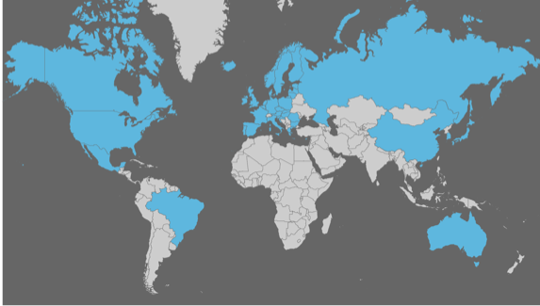

The Rise of Global Interoperability
Working together as peers and equals to expand opportunities for researchers worldwide
Building a multi-national group of FIDC testbeds, seeking new partners, working from a basis of equality to expand opportunities for researchers worldwide.
Building a multi-national group of FIDC testbeds, seeking new partners, working from a basis of equality to expand opportunities for researchers worldwide.

Slide 25








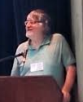
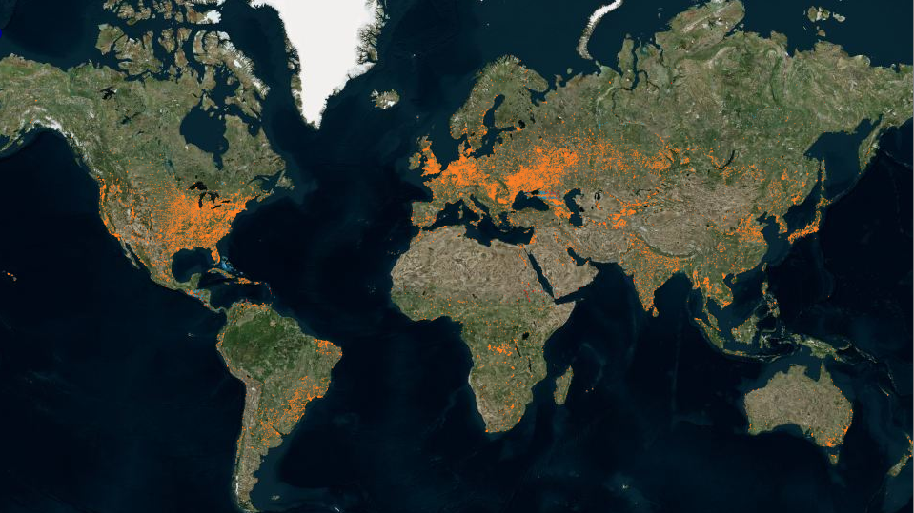
TransGeo Distributed Clouds: Think Globally, Compute Locally
Compute “green index” for cities worldwide
Rob Ricci
U. Utah
US
Yvonne Coady
U. Victoria
Canada
Rick McGeer
HP, US
Piet Demeester
Ughent
Belgium
Joe Mambertti
Northwestern
US
Paul Mueller
U. Kaiserslautern
Germany
Aki Nakao
U. Tokyo
Japan
Julio Ibarra
FIU, US
Michael Stanton
USP, Brazil
Federation fosters International Collaborations

Slide 26
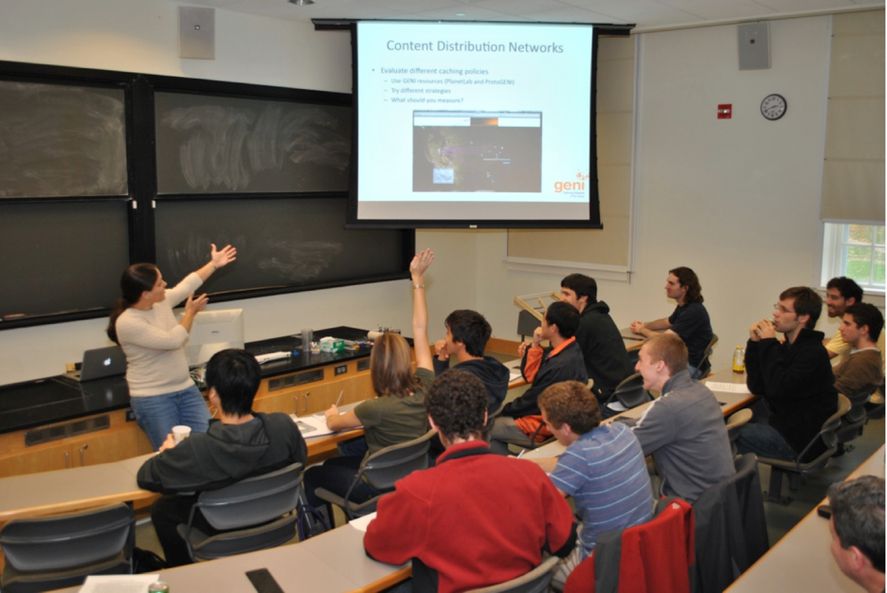
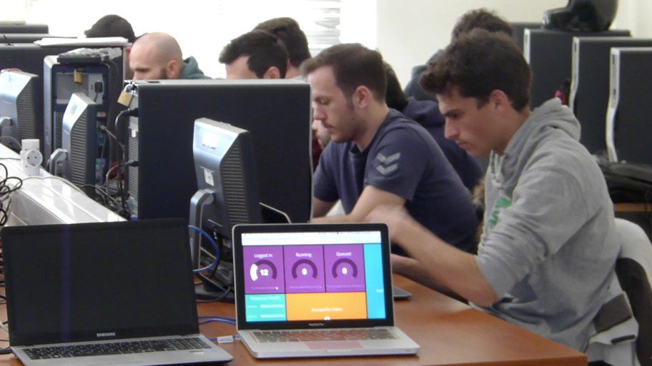
GENI in the Classroom
Over 6000 students
have used GENI in
classes taught by 90
instructors
GENI as a remote, virtual lab for
networking, distributed systems
and cloud computing classes

Slide 27

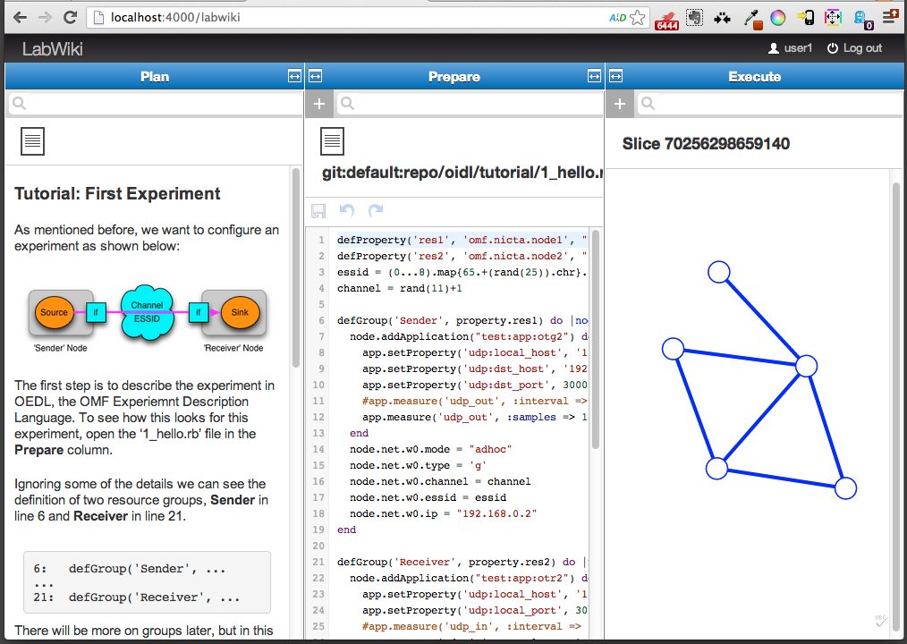
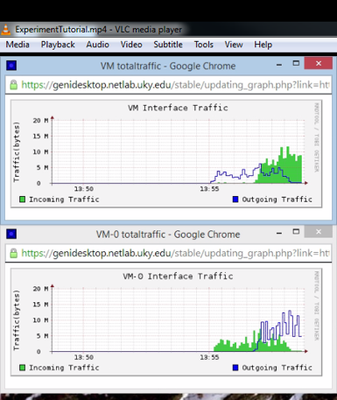
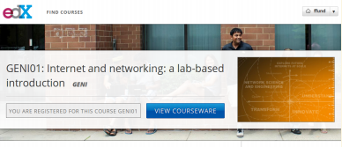
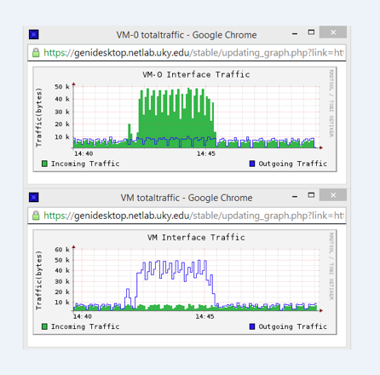

GENI-based Courseware
Labs on GENI for networking textbook
GENI Modules to teach
networking concepts
Mike Zink
UMass Amherst
Example Demo Module
Massive Online Open Courses on GENI
Use GENI to educate the Internet users, not the Internet creators.
Shivendra Panwar, Thanasis Korakis
NYU Poly
Example Assignment
Kevin Jaffay, Jay Aikat
UNC-Chapel Hill

Slide 28
Outline
What is GENI?
Building and deploying GENI
How is GENI being used?
An experimenter’s view of GENI
What’s next?

Slide 29
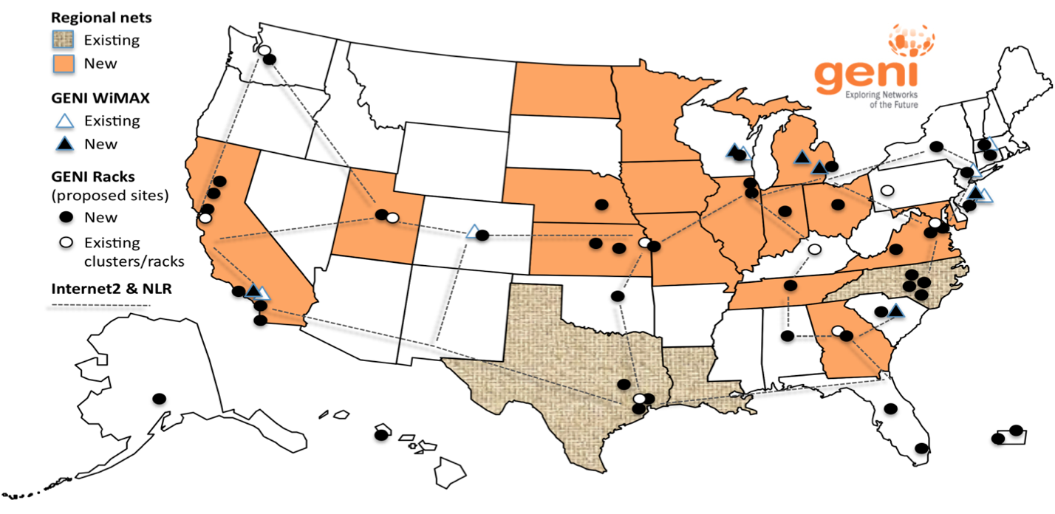
GENI: Terms and Definitions
Slice
Abstraction for a collection of resources capable of running experiments
An experiment uses resources in a slice
Slices isolate experiments
Experimenters are responsible for their slices

Slide 30
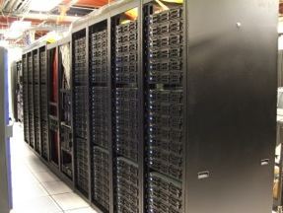
Clearinghouse and Aggregates
Create & Register Slice
users
projects
slices
Slice credentials
clearinghouse
Aggregate Manager API
- listResources
- createSliver
…
Researcher
Tool
Aggregate
Manager
Aggregate Resources
Clearinghouse: Manages users, projects and slices
Standard credentials shared via custom API or new Common CH API
GENI supported accounts: GENI Portal/CH, PlanetLab CH, ProtoGENI CH
Aggregate: Provides resources to GENI experimenters
Typically owned and managed by an organization
Speaks the GENI AM API
Examples: PlanetLab, Emulab, GENI Racks on various campuses

Slide 31
GENI: Terms and Definitions
Sliver: One or more resources provided by an aggregate
E.g. Bare machines, virtual machines, VLANs
Campus #3
My slice contains slivers from many aggregates.
Commercial
Clouds
Backbone #1
Campus
My GENI Slice
Access #1
Corporate
GENI suites
Research
Testbed
Backbone #2
Other-Nation
Projects
Campus #2

Slide 32
RSpecs
RSpecs: Lingua franca for describing and requesting resources
“Machine language” for negotiating resources between experiment and aggregate
Experimenter tools eliminate the need for most experimenters to write or read RSpec
<?xml version="1.0" encoding="UTF-8"?>
<rspec xmlns="http://www.protogeni.net/resources/rspec/2"
xmlns:xsi="http://www.w3.org/2001/XMLSchema-instance"
xsi:schemaLocation="http://www.protogeni.net/resources/rspec/2
http://www.protogeni.net/resources/rspec/2/request.xsd"
type="request" >
<node client_id="my-node"
exclusive="true">
<sliver_type name="raw-pc" />
</node>
</rspec>
RSpec for requesting a single node

Slide 33

Reserving Resources using RSpecs and the AM API
Experimenter tools and aggregates talk to each other using resource specifications (RSpecs) and the GENI Aggregate Manager API (GENI AM API)
Advertisement RSpec: What does an aggregate have?
Request RSpec: What does the experimenter want?
Manifest RSpec: What does the experimenter have?
What do you have?
I have …
ListResources(…)
I would like …
Advertisement RSpec
You have …
CreateSliver(Request RSpec, …)
Aggregate
Manager
Experimenter
Tool
What do I have?
Manifest RSpec
You have …
ListResources(SliceName, …)
Manifest RSpec

Slide 34
Use GENI for Your Research and Teaching
Experimenter and Educator resources on the GENI wiki
Tutorials
Ready-to-use exercises
Community support mailing lists
geni-users@googlegroups.com
geni-educators@googlegroups.com

Slide 35
Outline
What is GENI?
Building and deploying GENI
How is GENI being used?
An experimenter’s view of GENI
What’s next?

Slide 36
What’s Next?
These are interesting times!
Major trends are converging in software defined infrastructure
Economics favors pervasive computation and storage, i.e., “cloud-in-the-loop”
In 20 years, we expect much fuller spectrum occupancy than today
A deep transformation of the Internet is now underway

Slide 37
GENI Operations & Future
ENTeR: Enabling NeTwork Research and the Evolution of a Next Generation Midscale Research Infrastructure
GENI management transitioned in Fall 2018 from BBN to the ENTeR team (2-year NSF grant)
RENCI (UNC Chapel Hill): Ilya Baldin, Mert Cevik, Komal Thareja
University of Kentucky: Jim Griffioen, Zongming Fei, Hussam Nasir, Charles Carptenter
University of Maryland:Tom Lehman, Xi Yang
University of Utah: Rob Ricci, Aleks Maricq
Internet2: Matt Zekauskas, John Hicks, John Moore

Slide 38
GENI Operations & Future
The ENTeR team is responsible for operating the GENI infrastructure
Operates the GENI Portal/Clearing House
User accounts (InCommon, some from NCSA), project approval
Adding new GENI Racks, decommissioning old Racks
Running CAs for GENI user certificates and service certificates
Running Stitching Computation Services (SCS)
Monitors GENI Aggregates
Updates OS on GENI nodes
Maintains the domain (geni.net) and webpages including all tutorials, wiki pages
Provides user support
Handles Emergency Stop and other security issues

Slide 39
Attend a GENI Event
GENI @ NSF MERIF Workshops
GWU, May 29-30, 2019, Washington DC
Also includes: Chameleon, CloudLab, COSMOS/ORBIT, Edge-Net, and POWDER-RENEW
GENI Going Forward Workshop
Co-located with IEEE ICNP 2019, October 7-10, 2019, Chicago, IL
Subscribe to the geni-announce list
http://www.geni.net/contact-us/join-a-mailing-list/

Slide 40
THANKS... Questions?
Acknowledgement: This work is supported in part by the National Science Foundation under grants CNS-1836742, and CNS-1836715.
Subscribe to the geni-announce list
http://www.geni.net/contact-us/join-a-mailing-list/

